Slide 1
Question 1
Question:
What is a variable in C/C++?
Answer:
A variable is a named memory location used to store data. Its value can change during program execution, helping programs process and manage information efficiently.

Slide 2
Question 2
Question:
Why do we use variables in programs?
Answer:
Variables are used to store, update, and manipulate data. They make programs flexible by allowing values to change during execution when needed.

Slide 3
Question 3
Question:
What is the difference between a variable name and its value?
Answer:
A variable name identifies a memory location, while the value is the actual data stored in that location and used by the program.

Slide 4
Question 4
Question:
Which of the following is a valid variable name? a) 2num b) total_marks c) for d) my marks
Answer:
The correct answer is total_marks. It follows C++ naming rules because it starts with a letter and contains only valid characters.

Slide 5
Question 5
Question:
Why is Age different from age?
Answer:
C++ is case-sensitive. Therefore, Age and age are treated as two different variable names and can store different values.

Slide 6
Question 6
Question:
Can a variable name contain spaces? Why?
Answer:
No, variable names cannot contain spaces because the compiler treats spaces as separators between words, causing syntax errors.

Slide 7
Question 7
Question:
Can a variable name start with an underscore (_) ?
Answer:
Yes, a variable name can start with an underscore. However, meaningful names are generally preferred for better readability.

Slide 8
Question 8
Question:
What happens if two variables have the same name in the same scope?
Answer:
Using the same variable name in the same scope causes a redeclaration error because each variable must have a unique name.

Slide 9
Question 9
Question:
Write three meaningful variable names for storing student information.
Answer:
Examples include studentName, studentAge, and studentMarks. These names clearly describe the information being stored in each variable.

Slide 10
Question 10
Question:
Which naming convention is better and why: studentMarks or sm?
Answer:
studentMarks is better because it clearly describes the stored data, making the program easier to understand and maintain.

Slide 11
Question 11
Question:
What is a data type?
Answer:
A data type specifies the kind of data a variable can store, such as numbers, characters, decimal values, or logical values.

Slide 12
Question 12
Question:
Which data type is used to store whole numbers?
Answer:
The int data type is used to store whole numbers without decimal points in C++ programs.

Slide 13
Question 13
Question:
Which data type is used to store decimal values?
Answer:
Float and double data types are used to store decimal numbers. Double provides greater precision than float.

Slide 14
Question 14
Question:
What is the difference between float and double?
Answer:
Float stores decimal values with lower precision, while double stores them with higher precision and a larger range.

Slide 15
Question 15
Question:
Which data type stores a single character?
Answer:
The char data type stores a single character, such as a letter, digit, or special symbol.

Slide 16
Question 16
Question:
Which data type stores True/False values?
Answer:
The bool data type stores logical values and can contain only true or false.

Slide 17
Question 17
Question:
What data type is suitable for storing a person's name?
Answer:
The string data type is suitable for storing a person's name because it can hold multiple characters together.

Slide 18
Question 18
Question:
Predict the output: int age=18; cout<<age;
Answer:
The output will be 18 because the value stored in the variable age is displayed using cout.

Slide 19
Question 19
Question:
Identify the data type: 25, 3.14, 'A', true.
Answer:
25 is int, 3.14 is double, 'A' is char, and true is bool according to C++ data types.

Slide 20
Question 20
Question:
What happens if you store a decimal number in an int variable?
Answer:
The decimal portion is removed when storing a decimal value in an int variable, leaving only the whole number part.

Slide 21
Question 21
Question:
What is the purpose of cin?
Answer:
cin is used to accept input from the user and store it in variables during program execution.

Slide 22
Question 22
Question:
What is the purpose of cout?
Answer:
cout is used to display output, messages, and variable values on the screen for the user.

Slide 23
Question 23
Question:
Which symbol is used with cin?
Answer:
The extraction operator >> is used with cin to take input from the user.

Slide 24
Question 24
Question:
Which symbol is used with cout?
Answer:
The insertion operator << is used with cout to display output on the screen.

Slide 25
Question 25
Question:
Explain: cin >> age;
Answer:
This statement takes a value entered by the user and stores it in the variable age.

Slide 26
Question 26
Question:
Explain: cout << age;
Answer:
This statement displays the current value stored in the variable age on the screen.

Slide 27
Question 27
Question:
What is the purpose of endl?
Answer:
endl inserts a new line and moves the cursor to the beginning of the next line.

Slide 28
Question 28
Question:
Write a statement to input a student's marks.
Answer:
The statement is: cin >> marks; It accepts marks entered by the user and stores them.

Slide 29
Question 29
Question:
Write a statement to display 'Welcome to C++'.
Answer:
The statement is: cout << "Welcome to C++"; It displays the given message on the screen.

Slide 30
Question 30
Question:
Predict the output: cout << 'Programming';
Answer:
The output will be Programming because cout displays the text provided within the output statement.

Slide 31
Question 31
Question:
What is an operator?
Answer:
An operator is a symbol that performs mathematical, relational, logical, or other operations on variables and values.

Slide 32
Question 32
Question:
Which operator is used for addition?
Answer:
The plus sign (+) is used as the addition operator to add two or more values.

Slide 33
Question 33
Question:
What is the result of 10 % 3?
Answer:
The result is 1 because 10 divided by 3 leaves a remainder of 1.

Slide 34
Question 34
Question:
What is the result of 8 % 2?
Answer:
The result is 0 because 8 is completely divisible by 2 with no remainder.

Slide 35
Question 35
Question:
Which operator checks equality?
Answer:
The equality operator (==) is used to check whether two values are equal or not.

Slide 36
Question 36
Question:
What is the difference between = and == ?
Answer:
The = operator assigns a value to a variable, while == compares two values for equality.

Slide 37
Question 37
Question:
What is the result of 5 > 3?
Answer:
The result is true because 5 is greater than 3, making the comparison correct.

Slide 38
Question 38
Question:
What does && represent?
Answer:
&& represents the logical AND operator. It returns true only when both conditions are true.

Slide 39
Question 39
Question:
What does || represent?
Answer:
|| represents the logical OR operator. It returns true if at least one condition is true.

Slide 40
Question 40
Question:
What does ! represent?
Answer:
! represents the logical NOT operator. It reverses the logical value of a condition.

Slide 41
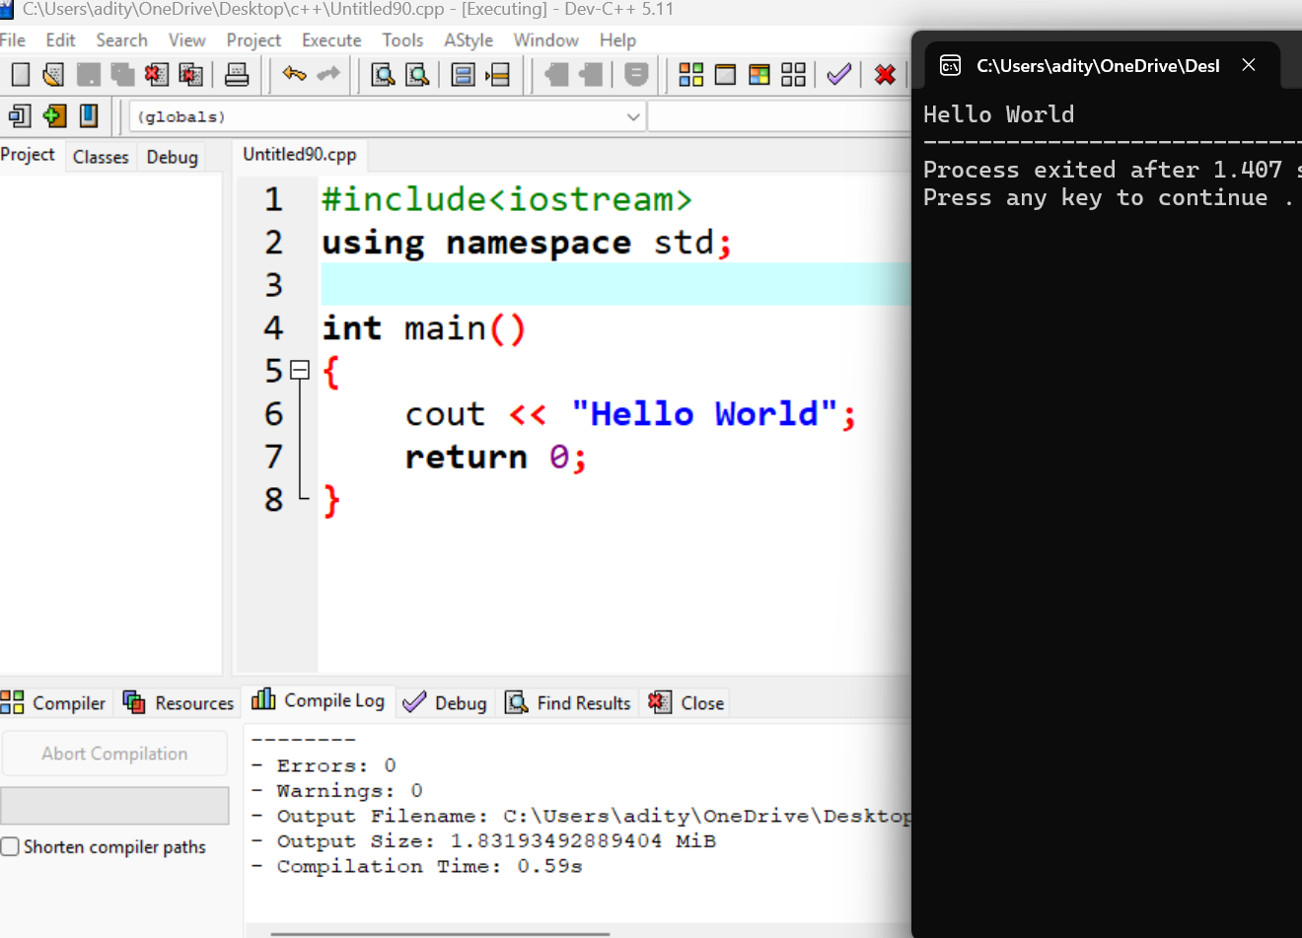
Question 41
Question:
Write a program to print 'Hello World'.

Slide 42
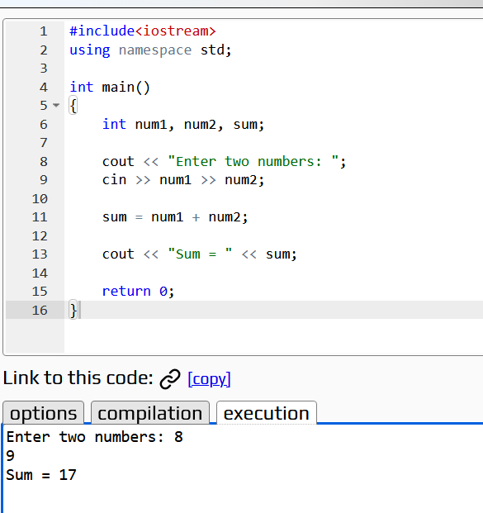
Question 42
Question:
Write a program to input two numbers and display their sum.

Slide 43
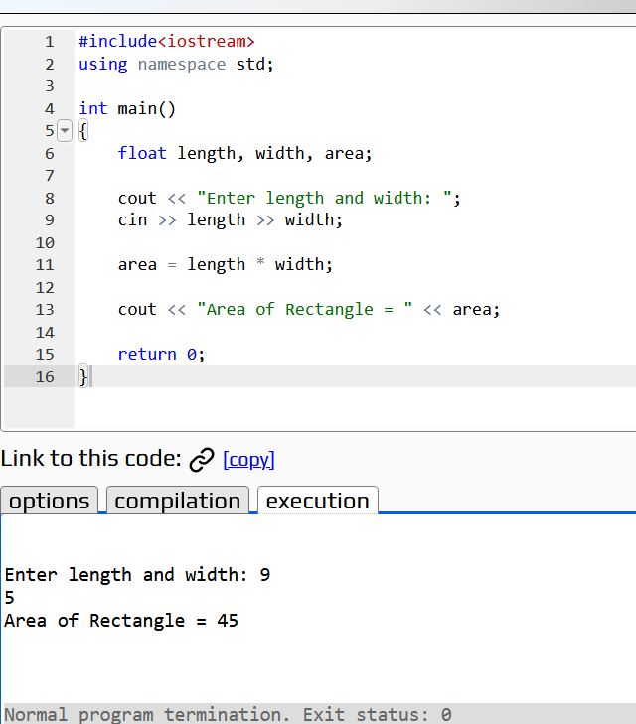
Question 43
Question:
Write a program to calculate the area of a rectangle.

Slide 44
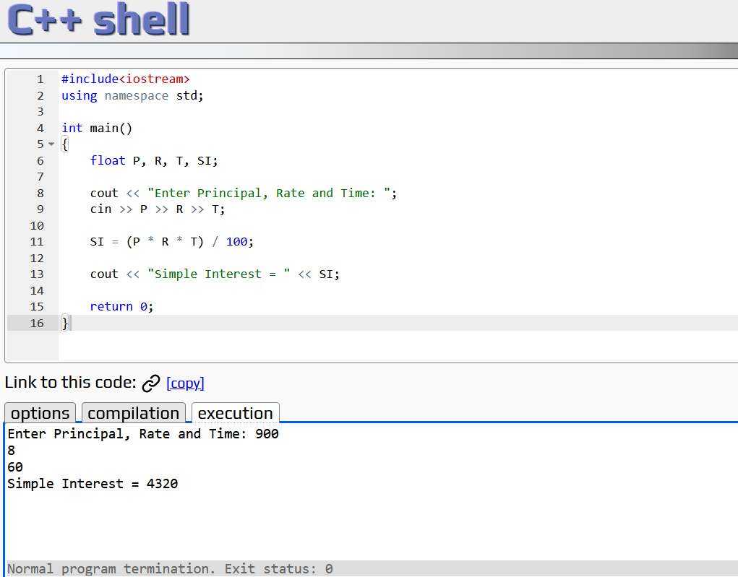
Question 44
Question:
What formula is used to calculate Simple Interest?
SI=(P*R*T)/100
Where P=Principal Value
R=Rate
T=Time

Slide 45
Question 45
Question:
Write a program to calculate Simple Interest.

Slide 46
Question 46
Question:
Why is a temporary variable used while swapping two numbers?
Answer:
A temporary variable is used to store one value temporarily during swapping. This prevents the original value from being lost before the exchange is completed.

Slide 47
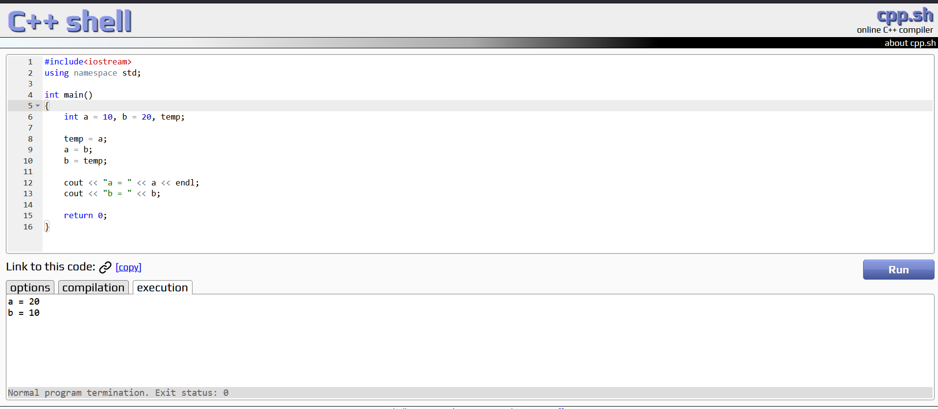
Question 47
Question:
Swap the values: a=10, b=20.

Slide 48
Question 48
Question:
What formula is used to convert Celsius into Fahrenheit?
F=(9/5*C)+32
Where, F=Fahrenheit
C=Celcius

Slide 49
Question 49
Question:
What is the Fahrenheit value of 0°C?
32 degree F

Slide 50
Question 50
Question:
Why can integer division give incorrect results in the Celsius-to-Fahrenheit program?
Answer:
Integer division removes the decimal part of a result. For example, 9/5 = 1 instead of 1.8, which can make the Fahrenheit calculation inaccurate.

